Slide 1

Cost of Capital [K_{o}]
(Unit - II)
Dr.M.Velavan
Faculty
School of Management
SASTRA Deemed University
Thanjavur – 613 401

Slide 2
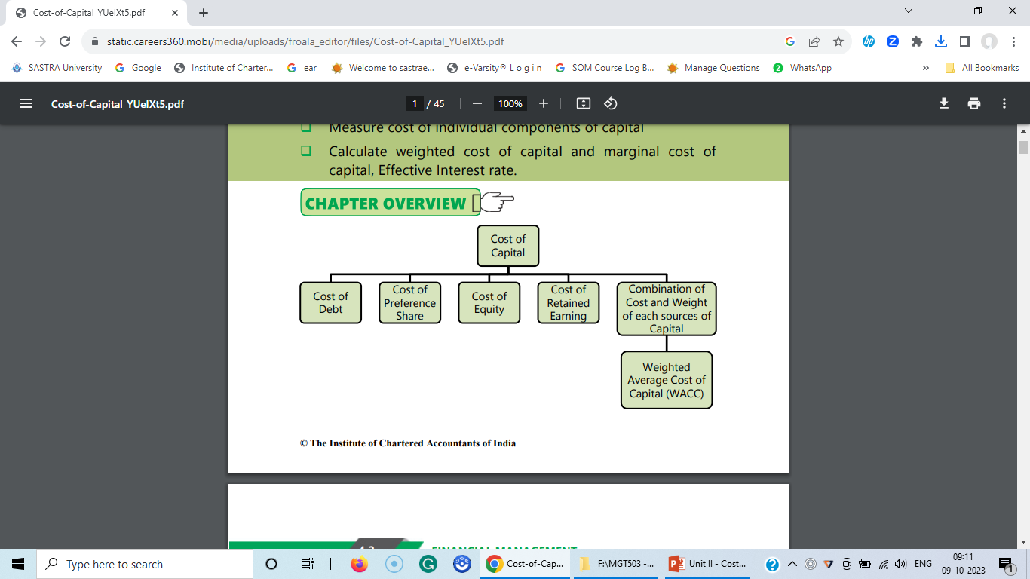
Overview:

Slide 3

Introduction:
The main objective of a business is to maximize the wealth of its shareholders in the long-run, the management should invest in those projects which give a return in excess of cost of funds invested in the project of the business. The cost of capital is the rate of return the company has to pay to various suppliers of funds in the company. It is also referred to as cut-off rate, target rate, hurdle rate, minimum required rate of return, standard rate etc. The cost of capital is the minimum rate of return, a firm has to earn to maintain its market value and value of its shares. The cost of capital is to be determined to help in managerial decision making like acceptance of capital investment proposals, appraisal of profitability and viability of subunits, restructuring of capital, raising of additional finances etc.

Slide 4
Example:
Capital structure of A Ltd. is as follows:
Here, debt-equity ratio is 40:60.
 | Equity and Liabilities: | Rs.
 | EPS/D Equity share capital [Owners Equity] | 50,00,000
 | ? Retained earnings [Owners Equity] | 20,00,000
 | 10 % Preference share capital [Owners Equity] | 20,00,000
 | 10 % Debentures [Debt] | 40,00,000
 | 15% loan from financial institutions [Debt] | 20,00,000
 | Total capital structure | 1,50,00,000

Slide 5
The Cost of Capital is the most important and controversial area in Financial Management. Capital Budgeting decisions have a major impact on the firm, and Cost of Capital is used as a criterion to evaluate the capital Budgeting decisions i.e., whether to accept or reject a project. Knowledge about cost of capital, and how it is influenced by financial leverage, is useful in making capital structure decisions. The cost of capital is the most important concept in financial decision making. The chief objective of measuring the cost of capital is its use as a decision criterion in capital budgeting.

Slide 6
Definition:
According to professor I.M.Pandy “Cost of Capital is the discount rate used in evaluating the desirability of the investment project. The cost of capital is the minimum rate of return required for investment project. The cost of capital is the minimum rate of return which will maintain the market value per share at its current level.
If the firm earns more than the cost of capital, the market value per share is expected to increase. In other words, it is the rate that suppliers of funds expect to get. It is determined by the cost of the various sources of finance. It is also referred to as the weighted average cost of capital or composite / combined cost of capital.
James C. Van Horne: The cost of Capital is “a cut-off rate for the allocation of capital to investments of projects. It is the rate of return on a project that will leave unchanged the market price of the stock”.

Slide 7
Soloman Ezra: “Cost of Capital is the minimum required rate of earnings or the cut-off rate of capital expenditure”.
It is clear from the above definitions that the cost of capital is that minimum rate of return which a firm is expected to earn on its investments so that the market value of its share is maintained. We can also conclude from the above definitions that there are three basic aspects of the concept of cost of capital:
Not a cost as such: In fact the cost of capital is not a cost as such, it is the rate of return that a firm requires to earn from its projects.
It is the minimum rate of return: A firm’s cost of capital is that minimum rate of return which will at least maintain the market value of the share.

Slide 8
iii) It comprises three components:
Where:
k = Cost of Capital,
r_{o}= Return at zero risk level,
b = Premium for business risk, which refers to the variability in operating profit (EBIT) due to change in sales,
f = Premium for financial risk which is related to the pattern of capital structure.
K_{o} = r_{o} + b + f

Slide 9
Importance of Cost of Capital
The Cost of Capital is very important in Financial Management and plays a crucial role in the following areas:
Capital budgeting decisions:
The cost of capital is used for discounting cash flows under Net Present Value method for investment proposals. So, it is very useful in capital budgeting decisions.
Capital structure decisions:
An optimal capital is that structure at which the value of the firm is maximum and cost of capital is the lowest. So, cost of capital is crucial in designing optimal capital structure.

Slide 10
(iii) Evaluation of final Performance:
Cost of capital is used to evaluate the financial performance of top management. The actual profitability is compared with the actual cost of capital of funds and if profit is greater than the cost of capital the performance nay be said to be satisfactory.
(iv) Other financial decisions:
Cost of capital is also useful in making such other financial decisions as dividend policy, capitalization of profits, making the rights issue, etc.

Slide 11
Classification of Cost of Capital:
Cost of Capital can be classified as follows:
Historical Cost and Future Cost:
Historical costs are book costs relating to the past, while future costs are estimated costs act as guide for estimation of future costs.
Specific Costs and Composite Costs:
Specific cost is the cost of a specific source of capital, while composite cost is combined cost of various sources of capital. Composite cost, also known as the weighted average cost of capital, should be considered in capital and capital budgeting decisions.

Slide 12
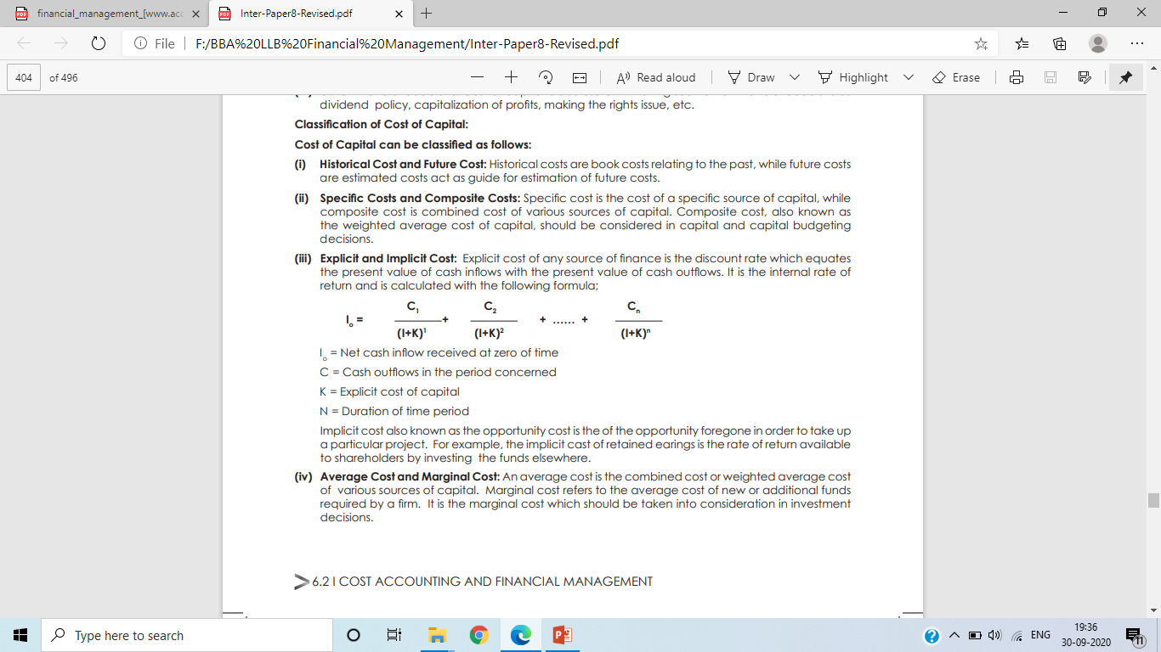
(iii) Explicit and Implicit Cost:
Explicit cost of any source of finance is the discount rate which equates the present value of cash inflows with the present value of cash outflows. It is the internal rate of return and is calculated with the following formula;
I o = Net cash inflow received at zero of time
C = Cash outflows in the period concerned
K = Explicit cost of capital
N = Duration of time period
Implicit cost also known as the opportunity cost is the of the opportunity foregone in order to take up a particular project. For example, the implicit cast of retained earnings is the rate of return available to shareholders by investing the funds elsewhere.

Slide 13
(iv) Average Cost and Marginal Cost:
An average cost is the combined cost or weighted average cost of various sources of capital. Marginal cost refers to the average cost of new or additional funds required by a firm. It is the marginal cost which should be taken into consideration in investment decisions.
Computation of Cost of Capital:
Computation of cost capital of a firm involves the following steps:
Computation of cost of each specific sources of a capital, viz., debt, preference capital, equity and retained earnings, and
Computation of weighted average cost of capital.

Slide 14
Computation of specific sources of capital:
Cost of Debt [K_{d}]:
Dent may be perpetual or redeemable debt. Moreover, it may be issued at par, at premium or discount. The computation of cost debt in each care is explained below.
1. Perpetual/irredeemable debt:
It is the rate of return which the lenders expect. A firm may issue perpetual bonds or it may have a policy of having a fixed amount of debt in the capital structure. In the case, when the old debt is repaid, it would be replaced by a new debt of same amount.

Slide 15
In such a case debt is regarded as perceptual debt. The bonds of debentures can be issued:
At par (face value),
At discount (below face value) and
At premium (more than the face value).
Thus, cost of perpetual debt is equal to the rate of return expected by the lenders. It is the coupon rate of interest which is adjusted for tax effect.

Slide 16
Cost of perpetual debt can be determined as before tax cost of debt and after tax cost of debt.
Symbolically:
a) Before tax cost of debt or K_{d} (before tax):
K_{d} = Interest/ Sale price of debenture of bond (p) or NP
NP = Face value + Premium – Discount – Floatation cost
b) After tax cost of debt or K_{d} (after tax)
K_{d} = [I/NP]× (1 – t)
I – Interest payment
P - Sale price of bond or debenture or NP
t – Tax rate
Or

Slide 17
K_{d} (After tax) = K_{d} (before tax) (1-t)
a) When debentures are Issued at Par:
Debt issued at par means, debt is issued at the face value of the debt. It may be calculated with the help of the following formula.
K_{d} = (1 – t) r
Where:
K_{d} = Cost of debt capital
t = Tax rate
r = Debenture interest rate

Slide 18
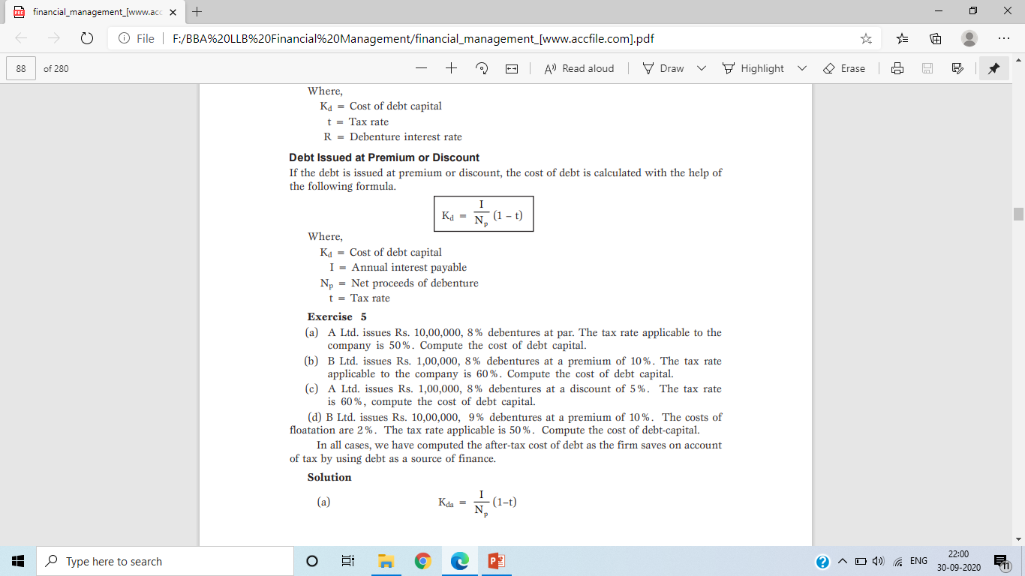
b) When debentures are issued at Premium:
If the debt is issued at premium, the cost of debt is calculated with the help of the following formula.
Where:
Kd = Cost of debt capital
I = Annual interest payable
Np = Net proceeds of debenture
t = Tax rate
Np = Face value + premium - floatation cost

Slide 19
c) When debentures are issued at discount:
If the debt is issued at discount, the cost of debt is calculated with the help of the following formula.
Where:
Kd = Cost of debt capital
I = Annual interest payable
Np = Net proceeds of debenture
t = Tax rate
Np = Face value – discount - floatation cost

Slide 20
Solved problem:
P1. a) A Ltd. issues Rs. 1,00,000, 8% debentures at par. The tax rate applicable to the company is 50%. Compute the cost of debt capital.
(b) B Ltd. issues Rs. 1,00,000, 8% debentures at a premium of 10%. The tax rate applicable to the company is 50%. Compute the cost of debt capital.
(c) A Ltd. issues Rs. 1,00,000, 8% debentures at a discount of 5%. The tax rate is 60%, compute the cost of debt capital.
(d) B Ltd. issues Rs. 1,00,000, 9% debentures at a premium of 10%. The costs of floatation are 2%. The tax rate applicable is 50%. Compute the cost of debt-capital.
In all cases, we have computed the after-tax cost of debt as the firm saves on account of tax by using debt as a source of finance.

Slide 21
Solution:
Issued at par:
K_{d} = (1 – t) r
= (1 - 0.50) × 8%
K_{d} = 4%
b) Issued at 10% premium:
I = Rs. 8,000, T = 50%
NP = Face value + Premium – floatation cost
= Rs. 1,00,000 + Rs. 10,000 – Nil
= Rs. 1,10,000.

Slide 22
= [Rs. 8,000/Rs. 1,10,000]×[1 - 0.50]
= [Rs. 8,000/Rs. 1,10,000]0.50
K_{d} = 3.63%
c) Issued at 8% discount:
I = Rs. 8,000, T = 60%
NP = Face value - discount – floatation cost
= Rs. 1,00,000 - Rs. 5,000 – Nil
= Rs. 95,000.

Slide 23
= [Rs. 8,000/Rs. 95,000]×[1 - 0.60]
= [Rs. 8,000/Rs. 95,000]0.40
K_{d} = 3.36%
d) Issued at 10% premium:
I = Rs. 9,000, T = 50%
NP = Face value + Premium – floatation cost
= Rs. 1,00,000 + Rs. 10,000 – 2,000 (Rs. 1,00,000×2/100)
= Rs. 1,08,000.

Slide 24
= [Rs. 9,000/Rs. 1,08,000]×[1 - 0.50]
= [Rs. 9,000/Rs. 1,08,000]0.50
K_{d} = 4.17%

Slide 25
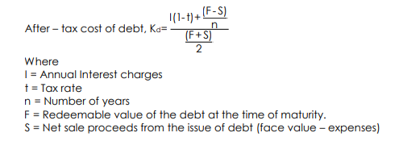
2). Cost of Redeemable debt:
While calculating the cost of redeemable debt, it is necessary to consider the repayment of the principal in addition to interest payments. The cost of redeemable debt can be calculated by suing the following formula.

Slide 26
P2. A firm issues debentures of Rs. 1,00,000 and realises Rs. 98,000 after allowing 2% commission to brokers. The debentures carry an interest rate of 10%. The debentures are due for maturity at the end of the 10th year. You are required to calculate the effective cost of debt both before and after tax cost. If the tax rate is 55%.
Solution:
K_{d} (before tax):
= {I + [P - Np]/n}/{[P + Np]/2}
= Rs. {Rs.10,000 + [Rs. 1,00,000 - Rs. 98,000]/10}/ {[Rs. 1,00,000 + Rs.
98,000]/2}
= Rs. 10,000 + 200/Rs. 99,000
= 0.103 or 10.33%

Slide 27
b) K_{d} (after tax):
= K_{d} (before tax) × (1 - t)
= 10.33 ( 1 - 0.55)
= 10.33 (0.45)
= 4.64%

Slide 28
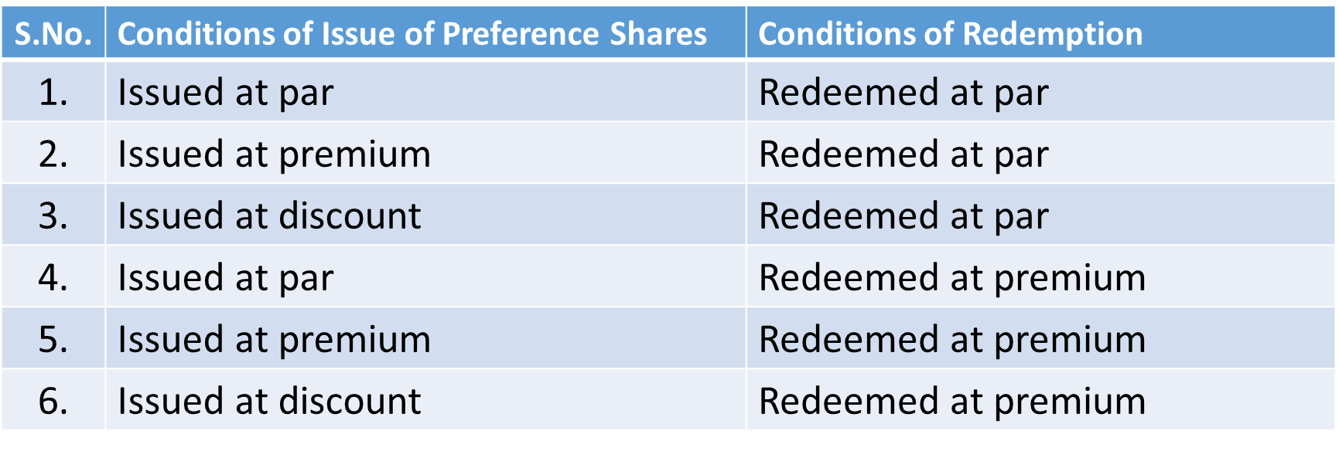
Note:
Conditions of issue and redemption of preference shares:

Slide 29
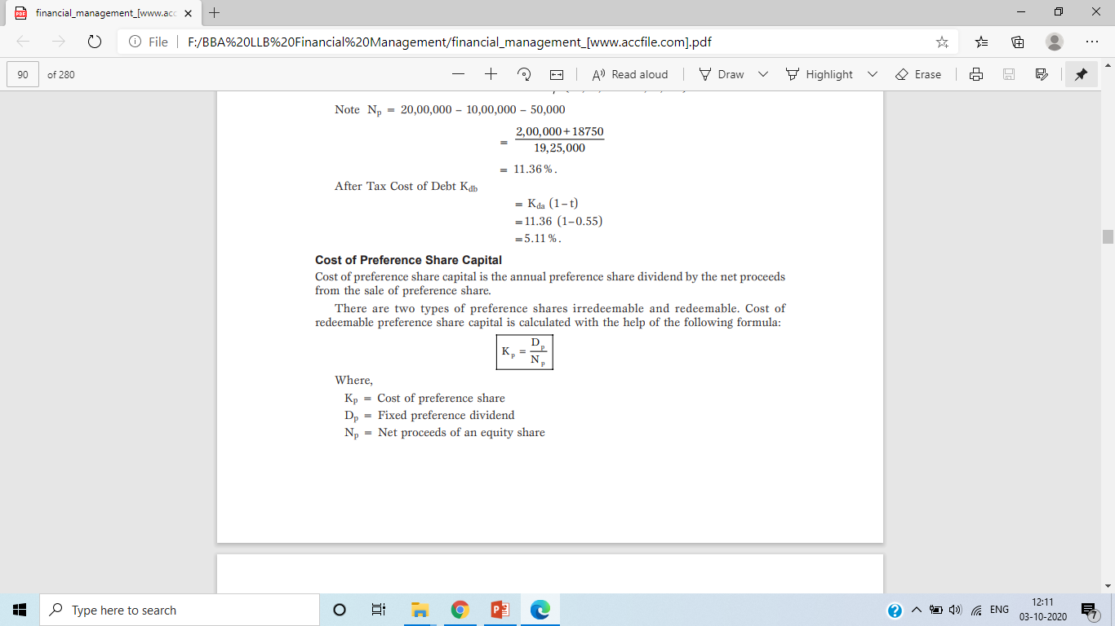
2. Cost of Preference Share Capital [K_{p}]:
Cost of preference share capital is the annual preference share dividend by the net proceeds from the sale of preference share. There are two types of preference shares irredeemable and redeemable. Cost of irredeemable preference share capital is calculated with the help of the following formula:
Where:
K_{p} = Cost of preference share
D_{p} = Fixed preference dividend
N_{p} = Net proceeds of an equity share

Slide 30
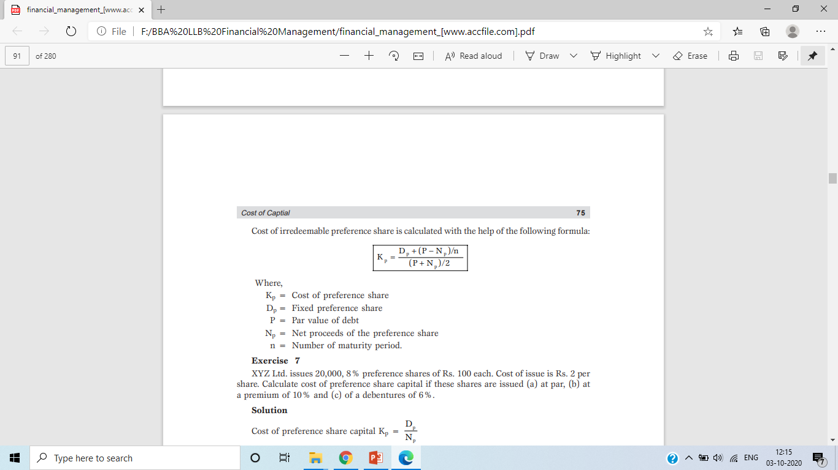
Cost of redeemable preference share is calculated with the help of the following formula:
Where:
K_{p} = Cost of preference share
D_{p} = Fixed preference share (Dividend)
P = Redeemable Value (RV)
N_{p} = Net proceeds of the preference share [FV+P-FC] or Sale Value
n = Number of maturity period.

Slide 31
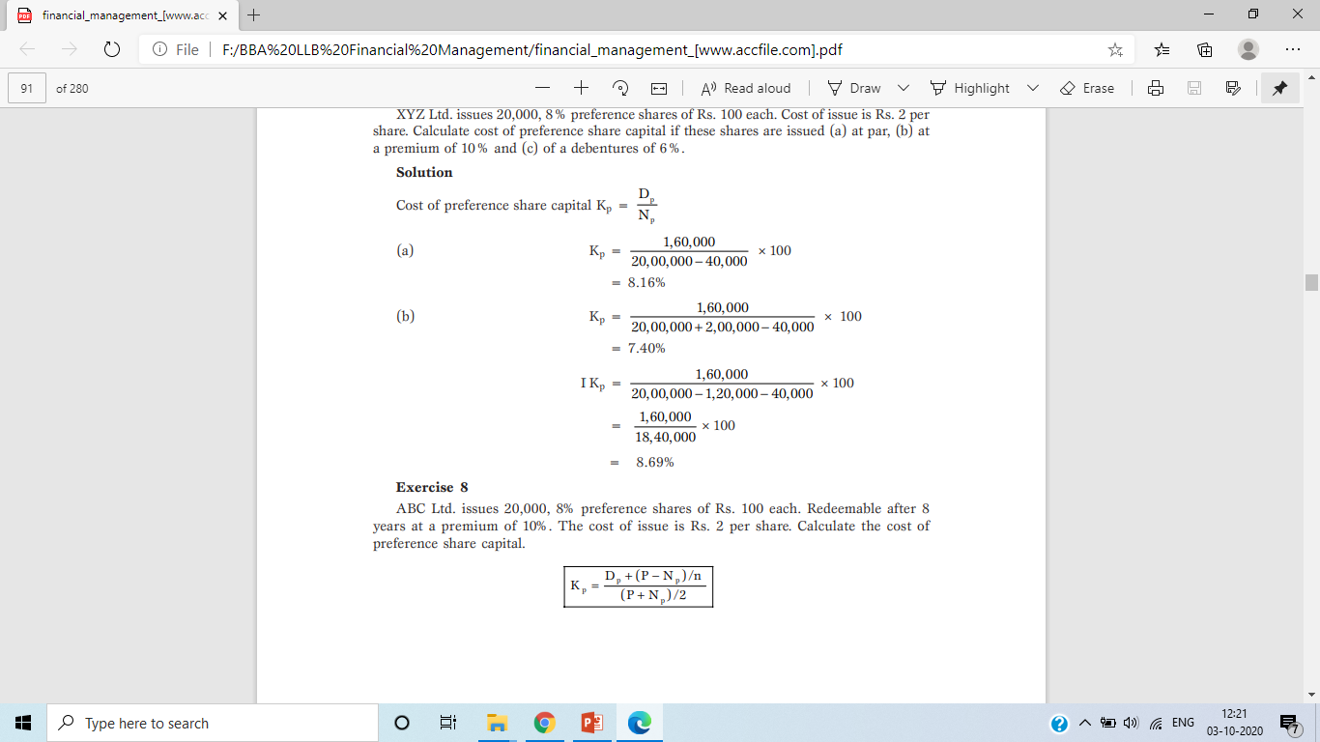
P3. XYZ Ltd. issues 20,000, 8% preference shares of Rs. 100 each. Cost of issue is Rs. 2 per share. Calculate cost of preference share capital if these shares are issued (a) at par, (b) at 10% premium and (c) at 6% discount.
Solution:
Cost of preference shares [K_{p}] =
Issued at par:
K_{p} = D/N_{p}
= Rs. 1,60,000 / [Rs. 20,00,000 – Rs. 40,000]
K_{p} = 8.16%

Slide 32
b) Issued at 10% premium:
K_{p} = D/N_{P}
D = Rs. 1,60,000,
Np = FV + Premium – Floatation cost
= Rs. 20,00,000 + Rs. 2,00,000 – Rs. 40,000
= Rs. 21,60,000
= Rs. 1,60,000 / Rs. 21,60,000
K_{p} = 7.40%

Slide 33
c) Issued at 6% discount:
K_{p} = D/Np
D = Rs. 1,60,000,
Np = FV - Discount – Floatation cost
= Rs. 20,00,000 - Rs. 1,20,000 – Rs. 40,000
= Rs. 18,40,000
= Rs. 1,60,000/Rs. 18,40,000
K_{p} = 8.69%

Slide 34
P4. ABC Ltd. issues 20,000, 8% preference shares of Rs. 100 each. Redeemable after 8 years at a premium of 10%. The cost of issue is Rs. 2 per share. Calculate the cost of preference share capital.
Solution:
Cost of preference shares =
D = Rs. 1,60,000, P = Rs. 22,00,000, Np = Rs. 19,60,000, n= 8
= Rs. 1,60,000 + {[Rs. 22,00,000 – Rs. 19,60,000] / 8} / {[Rs. 22,00,000 + Rs. 19,60,000] / 2}
= Rs. 1,60,000 + Rs. 30,000 / Rs. 20,80,000
= 1,90,000/20,80,000
= 9.13%

Slide 35
3. Cost of Equity (K_{e}):
Cost of equity capital is the rate at which investors discount the expected dividends of the firm to determine its share value. Conceptually the cost of equity capital (K_{e}) defined as the “Minimum rate of return that a firm must earn on the equity financed portion of an investment project in order to leave unchanged the market price of the shares”.
Cost of equity can be calculated from the following approach:
• Dividend price approach (D/P)
• Dividend price plus growth approach (D/P + g)
• Earning price approach (E/P)
• Realized yield approach.

Slide 36
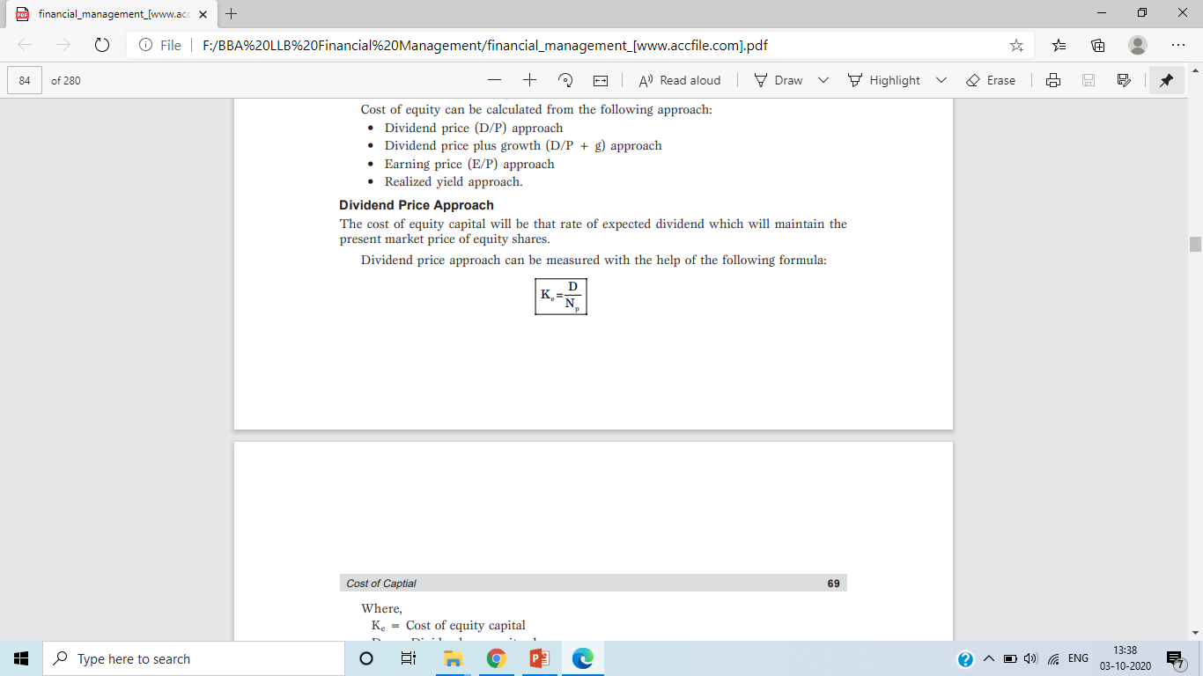
a) Dividend Price Approach(D/P):
The cost of equity capital will be that rate of expected dividend which will maintain the present market price of equity shares. Dividend price approach can be measured with the help of the following formula:
Where:
Ke = Cost of equity capital
D = Dividend per equity share
Np = Net proceeds of an equity share (FV)

Slide 37
P6. A company issues 10,000 equity shares of Rs. 100 each at a premium of 10%. The company has been paying 25% dividend to equity shareholders for the past five years and expects to maintain the same in the future also. Compute the cost of equity capital. Will it make any difference if the market price of equity share is Rs. 175?
Solution:
a) Calculation of K_{e}:
K_{e} = D/N_{p}
= Rs.25/Rs.110 [Rs. 100+Rs.10]
= 22.73%

Slide 38
b) If the market price of a equity share is Rs. 175.
K_{e} = D/MP
= Rs. 25/Rs. 175
Ke = 14.28%

Slide 39
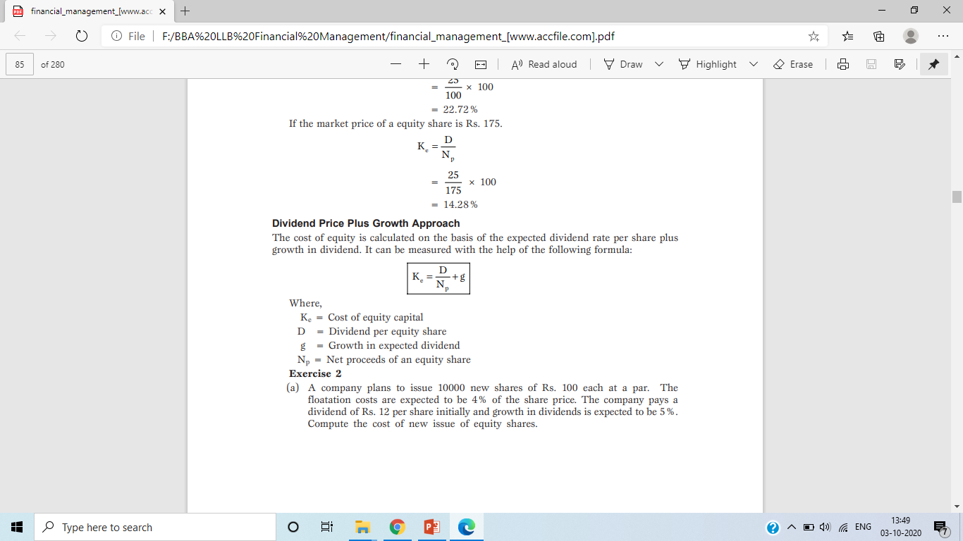
b) Dividend Price Plus Growth Approach (D/P + g):
The cost of equity is calculated on the basis of the expected dividend rate per share plus growth in dividend. It can be measured with the help of the following formula:
Where:
K_{e} = Cost of equity capital
D = Dividend per equity share
g = Growth in expected dividend
N_{p} = Net proceeds of an equity share

Slide 40
P7. A company plans to issue 10,000 new shares of Rs. 100 each at a par. The floatation costs are expected to be 4% of the share price. The company pays a dividend of Rs. 12 per share initially and growth in dividends is expected to be 5%. Compute the cost of new issue of equity shares. If the current market price of an equity share is Rs. 120. Calculate the cost of existing equity share capital.
Solution:
a) Calculation of cost of equity:
= {Rs. 12/[Rs. 100 – 4]} + 5%
= 12.5 % + 5%
Ke = 17.5%

Slide 41
b) Calculation of cost of equity:
If the Market price of equity share is Rs.120.
= [Rs. 12/Rs. 120] +5%
= 10% +5%
K_{e} = 15%

Slide 42
P8. The current market price of the shares of A Ltd. is Rs. 95. The floatation costs are Rs. 5 per share. The amount of dividend per share is Rs. 4.50 and is expected to grow at a rate of 7%. You are required to calculate the cost of equity share capital.
Solution:
Calculation of K_{e}:
= [Rs. 4.50 / Rs. 95]+ 7%
= 4.73% + 7%
= 11.73%

Slide 43
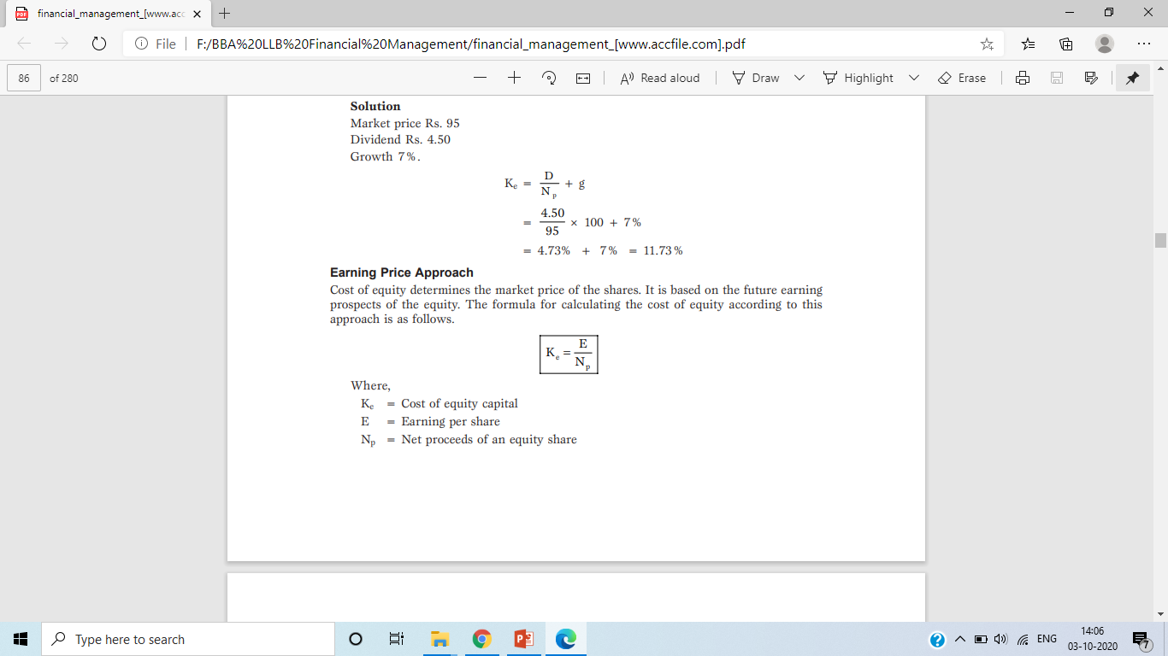
c) Earning Price Approach:
Cost of equity determines the market price of the shares. It is based on the future earning prospects of the equity. The formula for calculating the cost of equity according to this approach is as follows:
Where:
K_{e} = Cost of equity capital
E = Earning per share
N_{p} = Net proceeds of an equity share

Slide 44
P9. A firm is considering an expenditure of Rs. 75 lakhs for expanding its operations. The relevant information is as follows :
Number of existing equity shares = 10 lakhs
Market value of existing share = Rs.100
Net earnings = Rs.100 lakhs
Compute the cost of existing equity share capital and of new equity capital assuming that new shares will be issued at a price of Rs. 92 per share and the costs of new issue will be Rs. 2 per share.

Slide 45
Solution:
Calculation of K_{e}:
K_{e} = E/N_{p}
E = Net earnings / No of equity shares
= 100 lakh / 10 lakh
= 10 Per share
K_{e} = 10 / [Rs. 92 – Rs. 2] × 100
= 11.11%

Slide 46
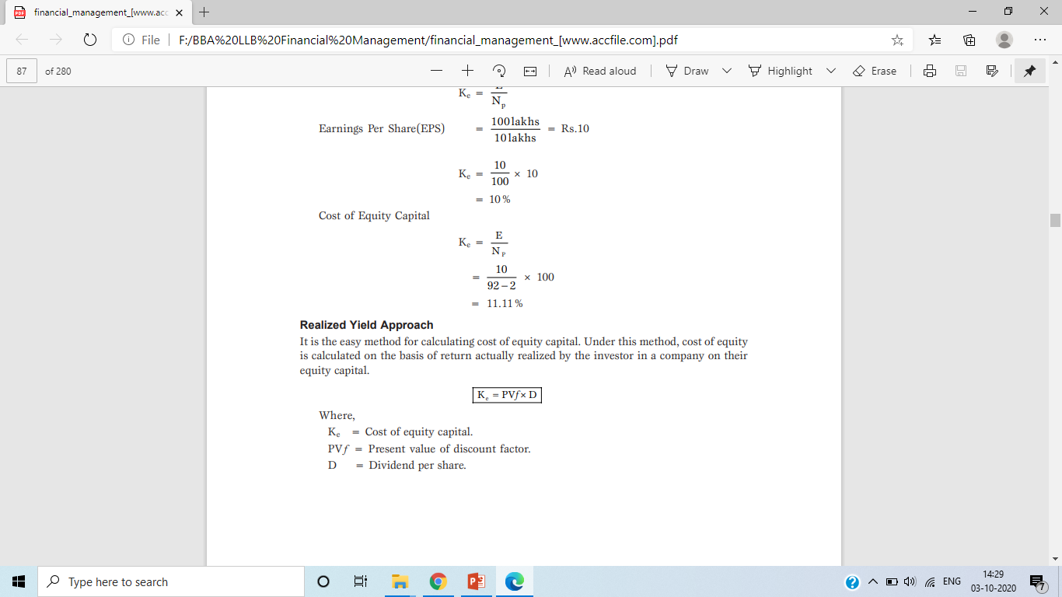
d) Realized Yield Approach:
It is the easy method for calculating cost of equity capital. Under this method, cost of equity is calculated on the basis of return actually realized by the investor in a company on their equity capital.
Where:
Ke = Cost of equity capital.
PVƒ = Present value of discount factor.
D = Dividend per share.

Slide 47

4. Cost of retained earnings (K_{r}):
The company do not generally distribute the entire profits earned by them by way of dividend among the shareholders. Some profits are retained by them for future expansion of the business. Many people feel that such retained earnings are absolutely cost free. This is not the correct approach because the amount received by company, if it had been distributed among the shareholders by way of dividend, would have given them some return. The has deprived the shareholders of this earnings by retaining a part of profit with it. Thus , the cost of retained earnings is the earnings forgone by the shareholders.
In other words, the opportunity cost of retained earnings my be taken as the cost of the retained earnings. It is equal to the income that the shareholders could have otherwise earned by placing these funds in alternative investments.

Slide 48
For example, if the shareholders could have invested the funds in alternative channels, they could have to get a return of 10%. This return of 10% has been forgone by them because of the company not distributing the full profits to them. The cost of retained earnings may, therefore, be taken at 10%.
The following adjustment are made for ascertaining the cost of retained earnings:
Income tax adjustment
Brokerage cost adjustment
The opportunity cost of retained earnings to the shareholders is, therefore, the rate of return that they can obtain by investing the net dividends (i.e., after tax and brokerage) in alternative opportunity of equal quality.

Slide 49
Solved problem:
P10. ABC Ltd. is earning a net profit of Rs. 50,000 per annum. The shareholders required rate of return is 10%. It is expected that retained earnings, if distributed among the shareholders, can be invested by them in securities of similar type carrying return of 10% per annum. It is further expected that the shareholders will have to incur 2% of the net dividends received by them as brokerage cost for making new investments. The shareholders of the company are in 30% tax bracket.
You are required to calculate the cost of retained earnings to the company.

Slide 50
Solution:
Calculation of net amount available for investment
Since the shareholders have the investment opportunity of earning 10%, The amount of earning received by them on their investment will amount to be Rs. 3,430.
 | Particulars | Rs.
 | Dividend payable to shareholders | 50,000
Less | Income tax @ 30% of Rs. 50,000 | 15,000
 | After tax dividend | 35,000
Less | Brokerage cost @ 2% of Rs. 35,000 | 700
 | Net amount available for investment | 34,300

Slide 51
In case the earnings had not been distributed by the company among its shareholders, the company could have full Rs. 50,000 for investment. Since no personal income tax and brokerage cost as above, would have been payable. The company could have paid a sum of Rs. 3430 to the shareholders if it could earn a return of 6.86% calculated as follows:
= [Rs.3,430/Rs. 50,000]×100
= 6.86%
The rate of return expected by the shareholders from the company on their rationed earnings comes to 6.86%. Therefore, It may taken as cost of retained earnings.

Slide 52
The cost of retained earnings after making adjustment for income tax and brokerage cost payable by the shareholders can be determined according to the following formula:
K_{r} = K_{e} (1-T) (1-B)
Where:
K_{r} = Required rate of return on retained earnings
K_{e} = Share holders required rate of return
T = Shareholders marginal tax rate
B= Brokerage cost

Slide 53
The cost retained earnings using the data given in the P10. can be calculated according to the above formula as follows:
K_{r} = K_{e} (1-T) (1-B)
= 10% (1 - 0.30) (1 - 0.02)
= 10% (0.70) ( 0.98)
= 6.86%

Slide 54
P10. A firm’s Ke (return available to shareholders) is 20%, the average tax rate of shareholders is 30% and it is expected that 2% is brokerage cost that shareholders will have to pay while investing their dividends in alternative securities. What is the cost of retained earnings?
Solution:
Calculation of K_{r}:
K_{r} = K_{e} (1-T) (1-B)
= 20% (1 - 0.30) (1 - 0.02)
= 20% (0.70) ( 0.98)
= 13.72%

Slide 55
P12. The company issues 10% irredeemable debentures of Rs. 1,00,000. The company is in the 55% tax bracket. Calculate the cost debt if the debentures are issued at a) par b) 10% premium and c) 10% discount.
P13. The firm issues debentures of Rs. 1,00,000 and realises Rs. 98,000 after allowing 2% commission to brokers. The debentures carry an interest of 10%. The debentureholders are due for maturity at the end of the 10th year. you are required to calculate the cost if debt.
P14. A company raised preference share capital of Rs. 1,00,000 by issue of 10% preference shares of Rs. 10 each. Calculate the cost of preference capital when they are issued at a) par, b) 10 premium and c) 10% discount.
P15. A company has 10% Rs. 1,00,000 redeemable preference shares redeemable at the end of the 10th year from the year of their issue. The underwriting cost came at %. Calculate the effective coat of preference share capital.

Slide 56
P16. A company offers for public subscription equity shares of Rs. 10 each at a premium of 10%. The company pays 5% of the issue price as underwriting commission. The rate of dividend expected by the equity shareholders is 20%. You are required to calculate the cost of equity capital. Will your cost of equity capital be different if it is to be calculated on the present market value of the equity share, which is Rs. 15?
P17. The current market price of an equity share of a company is Rs. 90. The current dividend per share is Rs. 4.50. In case the dividends are expected to grow at the rate of 7%. Calculate the cost of equity.
P18. The entire capital employed by a company consists of one lakh equity shares of Rs. 100 each. Its current earnings are Rs. 10 lakhs per annum. The company wants to raise additional funds of Rs. 25 lakhs by issuing new shares. The floatation costs are expected to be 10% of the face value of the shares. You are required to calculate the cost of equity.

Slide 57
b) Weighted Average Cost of Capital [W_{o} K_{o} ]:
It is also called as overall cost of capital and composite cost of capital. Weighted average cost of capital is the expected average future cost of funds over the long run found by weighting the cost of each specific type of capital by its proportion in the firms capital structure. The computation of the overall cost of capital (W_{o} K_{o}) involves the following steps.
Calculate the cost of each specific source of funds.
Assigning weights to specific costs.
This involves determination of the proportion of each source of funds in the total capital structure of the company. This may be done according to nay of the following method:

Slide 58
1. Marginal weights method:
In case of this method weights are assigned in each source of funds, in proportion of financing inputs the firm intends to employ. This method is based on this logic that our concern is with the new or incremental capital and not with capital raised in the past.
2. Historical weights method:
According to this method the relative proportion of various sources to the existing capital structure are used to assign weights. Thus, in case of this method the basis of weights is the fund already employed by the firm. Thus this based on the assumption that the firm‘s present capital structure is optimum and it should be maintained in the future also.

Slide 59
(c) Multiplying the cost of each of the sources by the appropriate weights.
(d) Adding of the weighted cost of all sources of funds to get an overall weighted average cost of capital.
The overall cost of capital can be calculated with the help of the following formula:
W_{o} K_{o} = W_{d} K_{d} + W_{p} K_{p} + W_{e} K_{e} + W_{r} K_{r}

Slide 60
Where:
W_{o} K_{o} = Weighted average cost of capital
K_{o} = Overall cost of capital
K_{d} = Cost of debt
K_{p} = Cost of preference share
K_{e} = Cost of equity
K_{r} = Cost of retained earnings
W_{d} = Percentage of debt to total capital
W_{p} = Percentage of preference share to total capital
W_{e} = Percentage of equity to total capital
W_{r} = Percentage of retained earnings to total capital

Slide 61
Solved problem:
P19. From the following capital structure of a company, calculate the overall cost of capital using a) Book Value Weights and b) Market Value Weights.
The after tax cost of different source of finance is as follows:
Equity Share Capital: 14%, Retained Earnings: 13%, Preference Share Capital; 10% and Debentures: 5%.
Source | Book Value (Rs.) | Market Value (Rs.)
Equity Share Capital @ Rs. 10 each | 45,000 | 90,000
Retained Earnings | 15,000 | Nil
Preference Capital | 10,000 | 10,000
Debentures | 30,000 | 30,000
Total | 1,00,000 | 1,30,000

Slide 62
Solution:
Computation of weighted average cost of capital [W_{o} K_{o} ]
[Book value weights]
Source (1) | Amount Rs. (2) | Proportion W_{o} (3) | After tax cost (4) | Weighted after tax cost (5) = (3) × (4)
Equity Share capital @ Rs. 10 each | 45,000 | 0.45 | 14% | 6.30%
Retained earnings | 15,000 | 0.15 | 13% | 1.95%
Preference share capital | 10,000 | 0.10 | 10% | 1.00%
Debentures | 30,000 | 0.30 | 5% | 1.50%
Total | 1,00,000 | 1.00 |  | 10.75%

Slide 63
b) Computation of weighted average cost of capital [W_{o} K_{o} ]
[Market value weights]
Source (1) | Amount Rs. (2) | Proportion W_{o} (3) | After tax cost (4) | Weighted after tax cost (5) = (3) × (4)
Equity Share capital @ Rs. 10 each | 90,000 | 0.692 | 14% | 9.688%
Preference share capital | 10,000 | 0.077 | 10% | 0.770%
Debentures | 30,000 | 0.231 | 5% | 1.155%
Total | 1,30,000 | 1.00 |  | 11.613%

Slide 64
P20. A Limited company has the following capital structure:
The market price of the company’s equity share is Rs. 20. It is expected that company will pay a current dividend of Rs. 2 per share which will grow at 7% for ever. The tax rate may be presumed at 50%. You are required to compute the following:
a) A weighted average cost of capital based on existing capital structure.
Particulars | Rs.
Equity share capital (2,00,000 shares) | 40,00,000
6% Preference shares | 10,00,000
8% Debentures | 30,00,000
Total | 80,00,000

Slide 65
b) The new weighted average cost of capital if the company raises an additional Rs. 20,00,000 debt by issuing 10% debentures. This would result in increasing the expected dividend to Rs. 3 and leave the growth rate unchanged but the, price of the share will fall to Rs. 15 per share.
c) The cost of capital if in (b) above, growth rate increases to 10 per cent.
Solution:
Working note:
1. Calculation of K_{e}:
K_{e} = [D/MP] + Growth Rate
= [Rs. 2/Rs. 20] + 7%
= 10% + 7%
= 17%

Slide 66
2. Calculation of Kd:
Kd = [1-T]R or [I/Np] × [1-T) = [Rs. 2,40,000/Rs. 30,00,000] × [1- 0.50]
= [1- 0.50] 8%
= 4%
3. Calculation of Kp:
Kp = D/NP
= [Rs.60,000/Rs. 10,00,000]×100
= 6%

Slide 67
Computation of weighted average cost of capital [W_{o} K_{o} ]
(As per the existing capital structure)
Source (1) | Amount Rs. (2) | Proportion W_{o} (3) | After tax cost (4) | Weighted after tax cost (5) = (3) × (4)
Equity Share Capital | 40,00,000 | 0.500 | 0.17 | 0.0850
Preference Share Capital | 10,00,000 | 0.125 | 0.06 | 0.0075
Debentures | 30,00,000 | 0.375 | 0.04 | 0.0150
Total | 80,00,000 | 1.00 |  | 10.75%

Slide 68
b) Working note:
Cost of K_{e}:
K_{e} = [D/MP] + Growth Rate
= [Rs. 3/Rs. 15] + 7%
= 20% + 7%
= 27%

Slide 69
Computation of weighted average cost of capital [W_{o} K_{o} ]
(As per the proposed capital structure)
Source (1) | Amount Rs. (2) | Proportion W_{o} (3) | After tax cost (4) | Weighted after tax cost (5) = (3) × (4)
Equity Share Capital | 40,00,000 | 0.40 | 0.27 | 0.108
6% Preference Share Capital | 10,00,000 | 0.10 | 0.06 | 0.006
8%Debentures | 30,00,000 | 0.30 | 0.04 | 0.012
10% Debentures | 20,00,000 | 0.20 | 0.05 | 0.010
Total | 1,00,00,000 | 1.00 |  | 13.60%

Slide 70
c) Working note:
Calculation of K_{e}:
K_{e} = [D/MP] + Growth Rate
= [Rs. 3/Rs. 15] + 10%
= 20% + 10%
= 30%

Slide 71
Computation of weighted average cost of capital [W_{o} K_{o} ]
(As per the proposed capital structure)
Source (1) | Amount Rs. (2) | Proportion W_{o} (3) | After tax cost (4) | Weighted after tax cost (5) = (3) × (4)
Equity Share Capital | 40,00,000 | 0.40 | 0.30 | 0.120
6% Preference Share Capital | 10,00,000 | 0.10 | 0.06 | 0.006
8%Debentures | 30,00,000 | 0.30 | 0.04 | 0.012
10% Debentures | 20,00,000 | 0.20 | 0.05 | 0.010
Total | 1,00,00,000 | 1.00 |  | 14.87%

Slide 72
P21. Your company share is quoted in the market at Rs. 20 currently. The company pays a dividend of Re. 1 per share and the investor expects a growth rate of 5% per year. Compute:
The company’s cost if capital.
If the anticipated growth rate is 6% p.a., calculate the indicated market price of the share.
If the company’s cost of capital is 8% and anticipated growth rate is 5% p.a., calculate the indicated market price of the dividend of Re. 1 per share is to be maintained.

Slide 73
Solution:
The relationship among coat of capital, dividend , price and growth rate is given by the formula:
Ke = [(D/MP) ×100] + Growth rate
Calculation of cost of capital:
K_{e} = [(Re.1/Rs.20) × 100] + 5%
K_{e} = 10%
b) Market price per share:
MP = [Dividend / [Cost of equity – Growth rate)]
= [Re. 1 / [10% - 6%)]
MP = Rs. 25

Slide 74
c) Calculation of Market price:
MP = MP = [Dividend / [Cost of equity – Growth rate)]
= [Re. 1 / [8% - 5%)]
MP = Rs. 33.33

Slide 75
P22. You are required to determine the weighted average cost of capital of KC Ltd., using (i) Book value weights and (ii) Market value weights. The following information is available for your perusal:
The KC Ltd.’s present book value of capital structure is:
All these securities are traded in the capital markets. Recent prices are, Debentures @ Rs. 110, Preference shares @ Rs. 120 and Equity shares @ Rs. 22.
Particulars | Rs.
Debentures [Rs. 100 per debentures] | 8,00,000
Preference shares [Rs. 100 per share] | 2,00,000
Equity Shares {Rs. 10 per share] | 10,00,000
Total | 20,00,000

Slide 76
Anticipated external financial opportunities are:
Rs. 100 per debentures redeemable at par, 20 years maturity, 8% coupon rate, 4% floatation cost, sale price Rs. 100.
Rs. 100 preference shares redeemable at par, 15 years maturity, 10% dividend rate, 5% floatation cost and sale price Rs. 100.
Equity shares: Rs. 2 per share floatation costs, sale price Rs. 22.
In addition the dividend expected on the equity share at the end of the year in Rs. 2 per share, the anticipated growth rate in dividends is 5% and the company has the practice of paying all its earnings in the form of dividends. The corporate tax rate is 50%.

Slide 77
Solution:
Working Note:
Calculation of K_{d} (before tax):
Kd = I+[(RV-SV)/n]/(RV + SV)/2]
= Rs. 8 + [(Rs. 100 – Rs. 96)/20] / [(Rs. 100 + Rs.96)/2]
= 8.36%
Therefore, K_{d} (after tax):
= Kd (before tax) (1-T)
= 8.36% (1.0.50)
= 8.36%(0.50)
Kd = 4.18%

Slide 78
2. Calculation of K_{p}:
Kp = D+[(RV-SV)/n]/(RV + SV)/2]
= Rs. 10+[(Rs. 100 – Rs. 95)/15] / [(Rs. 100 + Rs.95)/2]
= Rs. 10.33/ Rs. 97.5
Kp = 10.59%
3. Calculation of K_{e}:
Ke = (D/NP) + g
= [Rs. 2/(Rs. 22 – Rs. 2)] + 5%
= 10% + 5%
Ke = 15%.

Slide 79
Computation of weighted average cost of capital [W_{o} K_{o} ]
[Book value weights]
Source (1) | Amount Rs. (2) | Proportion W_{o} (3) | After tax cost (4) | Weighted after tax cost (5) = (3) × (4)
Debentures (Rs. 100 per debentures) | 8,00,000 | 0.40 | 0.0418 | 0.0167
Preference share capital (Rs. 100 per share) | 2,00,000 | 0.10 | 0.1059 | 0.0106
Equity shares Rs. 10 per share | 10,00,000 | 0.50 | 0.1500 | 0.0750
Total | 20,00,000 | 1.00 |  | 10.23%

Slide 80
b) Computation of weighted average cost of capital [W_{o} K_{o} ]
[Market value weight]
Source (1) | Amount Rs. (2) | Proportion W_{o} (3) | After tax cost (4) | Weighted after tax cost (5) = (3) × (4)
Debentures (Rs. 110 per debentures) | 8,80,000 | 0.2651 | 0.0418 | 0.01108
Preference share capital (Rs. 120 per share) | 2,40,000 | 0.0723 | 0.1059 | 0.00766
Equity shares Rs. 22 per share | 22,00,000 | 0.6626 | 0.1500 | 0.09939
Total | 33,20,000 | 1.00 |  | 11.81%

Slide 81
P23. The KC Ltd.’s present book value of capital structure is:
Particulars | Rs.
Equity capital (in shares of Rs.10 each, fully paid up at par) | Rs. 15 Crore
11% Preference capital (Rs.100 each, fully paid up at par) | Rs. 1 Crore
Retained earnings | Rs. 20 Crore
13.5% Debentures (of Rs.100 each) | Rs. 10 Crore
15% Term loans | Rs. 12.5 Crore
Total | Rs. 58.5 Crore

Slide 82
The next expected dividend on equity shares per share is Rs.3.60; the dividend per share is expected to grow at the rate of 7 percent. The market price per share is Rs.40. Preference stock, redeemable after ten years, is currently selling at Rs.75 per share. Debentures, redeemable after six years, are selling at Rs.80 per debenture. The Income-tax rate for the company is 40 percent. Required: Calculate the weighted average cost of capital using:
Book value proportions; and
Market value proportions.

Slide 83
Solution:
Working Note:
Calculation of K_{d} (before tax):
Kd = I+[(RV-SV)/n]/(RV + SV)/2]
= Rs. 13.5 + [(Rs. 100 – Rs. 80)/6] / [(Rs. 100 + Rs.80)/2]
= 18.7%
Therefore, K_{d} (after tax):
= Kd (before tax) (1-T)
= 18.7% (0.60)
= 18.70%(0.60)
Kd = 11.22%

Slide 84
2. Cost of Term Loans (K_{T})
K_{T} = R (1-T)
= 15%(0.60)
= 9%

Slide 85
3. Calculation of K_{p}:
Kp = D+[(RV-SV)/n]/(RV + SV)/2]
= Rs. 11+[(Rs. 100 – Rs. 75)/10] / [(Rs. 100 + Rs.75)/2]
= Rs. 13.50/ Rs. 87.5
Kp = 15.43%
4. Calculation of K_{e}:
Ke = (D/NP) + g
= [Rs.3.60/(Rs. 40)] + 7%
= 9% + 7%
Ke = 16%.

Slide 86
Computation of weighted average cost of capital [W_{o} K_{o} ]
[Book value weights]
Source (1) | Amount Rs. In crore (2) | Proportion W_{o} (3) | After tax cost (4) | Weighted after tax cost (5) = (3) × (4)
Equity capital | 15.0 | 0.256 | 0.1600 | 0.04096
11% Preference capital | 1.0 | 0.017 | 0.1543 | 0.00262
Retained earnings | 20.0 | 0.342 | 0.1600 | 0.05472
13.5% Debentures | 10.0 | 0.171 | 0.1122 | 0.01919
15% Term loans | 12.5 | 0.214 | 0.0900 | 0.01926
Total | 58.5 | 1.000 |  | 0.1367 Or 13.67%

Slide 87
b) Computation of weighted average cost of capital [W_{o} K_{o} ]
[Market value weight]
Source (1) | Amount Rs. In crore (2) | Proportion W_{o} (3) | After tax cost (4) | Weighted after tax cost (5) = (3) × (4)
Equity capital [1.50 Crore shares@ Rs. 40 each] | 60.00 | 0.739 | 0.1600 | 0.11824
11% Preference capital [1 Lakh shares @ Rs. 75 each] | 0.75 | 0.009 | 0.1543 | 1.3887
13.5% Debentures [10 Lakh Debentures @ Rs. 80 each] | 8.00 | 0.098 | 0.1122 | 0.01099
15% Term loans | 12.50 | 0.154 | 0.0900 | 0.01386
Total | 81.25 | 1.000 |  | 0.15317 Or 15.32%

Slide 88
P23. The capital structure of Anand Ltd in book value terms is as follows:
Particulars | Rs. (In Million)
Equity Capital (20 Million Shares, Rs. 10 par) | 200
12% Preference Capital (5 Lakh Shares, Rs. 100 par) | 50
Retained Earnings | 350
14% Debentures (12 Lakh Debentures, Rs. 100 par) | 120
13% Term Loans | 80
Total | 800

Slide 89
The next expected dividend per share is Rs 2.00. The dividend per share is expected to grow at the rate of 12%. Market price per share is Rs 50.00. Preference stock redeemable after 10 years, is currently selling for Rs 85.00 per share. Debentures, redeemable after 5 years are selling for Rs 90.00 per debenture. The tax rate for the company is 30%. Calculate the weighted average cost of capital.
Book value proportions; and
Market value proportions.

Slide 90
Solution:
Working Note:
Calculation of K_{d} (before tax):
Kd = 14+[(RV-SV)/n]/(RV + SV)/2]
= Rs. 14 + [(Rs. 100 – Rs. 90)/5] / [(Rs. 100 + Rs.90)/2]
= 16.84%
Therefore, K_{d} (after tax):
= Kd (before tax) (1-T)
= 16.84% (0.70)
Kd = 11.78%

Slide 91
2. Cost of Term Loans (K_{T})
K_{T} = R (1-T)
= 13%(0.70)
= 9.1%

Slide 92
3. Calculation of K_{p}:
Kp = D+[(RV-SV)/n]/(RV + SV)/2]
= Rs. 12+[(Rs. 100 – Rs. 85)/10] / [(Rs. 100 + Rs.85)/2]
= Rs. 13.5/ Rs. 92.5
Kp = 14.59%
4. Calculation of K_{e}:
Ke = (D/NP) + g
= [Rs.2/(Rs. 50)] + 12%
= 4% + 12%
Ke = 16%.

Slide 93
Computation of weighted average cost of capital [W_{o} K_{o} ]
[Book value weights]
Source (1) | Amount Rs. In crore (2) | Proportion W_{o} (3) | After tax cost (4) | Weighted after tax cost (5) = (3) × (4)
Equity Capital (20 Million Shares, Rs. 50 par) | 200.00 | 0.2500 | 0.1600 | 0.0400
12% Preference Capital (5 Lakh Shares, Rs. 100 par) | 50.00 | 0.0625 | 0.1459 | 0.0091
Retained Earnings | 350.00 | 0.4375 | 0.1600 | 0.0700
14% Debentures (12 Lakh Debentures, Rs. 100 par) | 120.00 | 0.1500 | 0.1178 | 0.0177
13% Term Loans | 80.00 | 0.1000 | 0.0910 | 0.0091
Total | 800.00 | 1.0000 |  | 14.59%

Slide 94
b) Computation of weighted average cost of capital [W_{o} K_{o} ]
[Market value weight]
Source (1) | Amount Rs. In crore (2) | Proportion W_{o} (3) | After tax cost (4) | Weighted after tax cost (5) = (3) × (4)
Equity Capital (20 Million Shares, Rs. 50 par) | 1000.00 | 0.8127 | 0.1600 | 0.1300
12% Preference Capital (5 Lakh Shares, Rs. 85 par) | 42.50 | 0.0345 | 0.1459 | 0.0050
14% Debentures (12 Lakh Debentures, Rs. 90 par) | 108.00 | 0.0878 | 0.1178 | 0.0103
13% Term Loans | 80.00 | 0.0650 | 0.0910 | 0.0059
Total | 1230.50 | 1.0000 |  | 15.12%

Slide 95
Thank You

